Slide 1
What you Need to Know About The April Exams
Presented by
Raymond Mathe, PLS – Senior Registrar
Board for Professional Engineers, Land Surveyors and Geologists (BPELSG)
November 8, 2012
Central Valley Chapter CLSA
Land Surveyor Review Class
Notes:
Raymond Mathe, PLS, is Senior Registrar Land Surveyor of the California Board for Professional Engineers, Land Surveyors, and Geologists (BPELSG). Prior to his appointment in February of 2012, he served as County Surveyor of the County of Orange. His experience includes project management in private practice and he also served as the Deputy County Surveyor for the County of Riverside. Ray obtained a Bachelor of Science degree in Workforce Education and Development from Southern Illinois University at Carbondale in 1995.
Responsibilities
Exam Manager
L.S. Advisor

Slide 2
PLS Exam Overview
PS/PLS Test Plans
CBT – Computer Based Testing
Results
Future Plans
New Fee Structure
Questions

Slide 3
NCEES PS Test Specifications
New – Effective beginning with April 2013 National PS Exam
Standards and Specifications – 12%
Legal Principles – 26%
Professional Survey Practices – 26%
Business / Professional Practices – 20%
Types of Surveys – 16%
http://www.ncees.org/Documents/Public/Exam%20specifications/PS%20Apr%202013.pdf
Notes:
See NCEEC Website
Questions WILL be in these categories, in the listed proportions!

Slide 4
State PLS Test Plan
Based on a 2011 Occupational Analysis of practicing California Land Surveyors
Project Management – 13%
Research Pre and Post Field Analysis – 25%
Field Work – 20%
Mapping and Document Preparation – 28%
Consultation and Legal – 14%
http://www.bpelsg.ca.gov/applicants/ls_test_plan.pdf
Notes:
See BPELSG Website
Questions WILL be in these categories, in the listed proportions!

Slide 5
Why CBT?
Improved Testing Environment
Larger number of test locations
Results Sooner
Ultimately more frequent
Greatly minimize security risks
Uniformity of exam testing environment
Better assessment of minimum competency
More sophisticated / appropriate content

Slide 6
State CBT Exam Tips
Bring:
Valid Government Issued Identification
Candidate Information Bulletin (CIB)
Reference Materials
Calculators
Limit the Materials
Books
Calculators
Scales, protractors, etc.
Notes:
Review CIB

Slide 7
State CBT Exam Tips
Other Items You Might Bring:
Batteries, extra glasses, other loose items
Put in personal locker or leave in car
Your exam time will NOT be stopped to retrieve from locker or car!
DO NOT bring:
Watch, clock, gloves, electronic devices
Notes:
Review CBT Screen Shots

Slide 8
NCEESExam Tips
PS Exam is now Closed Book
Wrist watches are OK
DO NOT bring:
CELL PHONES
Food, drinks, watch calculators, other electronic devices…
http://www.youtube.com/watch?v=KXECgt0JsRE

Slide 9
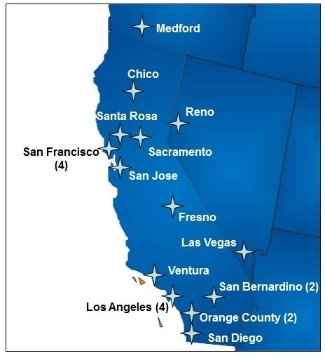
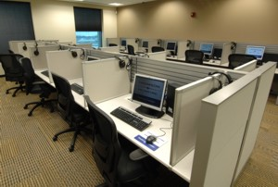
CBT – State Exam
250 Prometric CBT Centers
North America

Slide 10
Spring 2012 Results
406 Approved and Scheduled PLS Applicants
384 appeared and scored
24% Pass (91)
2011 (21.6%); 2010 (23.2%); 2009 (31.3%); 2008 (32%)
Results released June 4 (42 days after admin)

Slide 11
“A new era in how the Board measures the competency of individuals desiring to practice land surveying in this state has begun.”

Slide 12
PLS Exam - Future
NCEES Principles and Practice of Surveying (PS) Exam – Closed Book beginning April 2013
Fall 2013 – Goal to begin offering California PLS exam twice a year

Slide 13
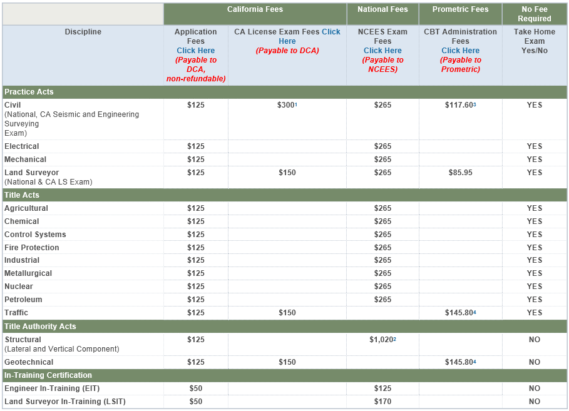
BPELSG – New Fee Structure

Slide 14
Land Surveyor:
Raymond Mathe (916) 263-2271 Raymond.mathe@dca.ca.gov
Executive Officer:
Ric Moore (916) 263-2230 Ric.moore@dca.ca.gov
Enforcement:
Nancy Eissler (916) 263-2241 Nancy.eissler@dca.ca.gov
Monument Conservation (Sec. 8771):
Larry Kereszt (916) 263-2240 Larry.kereszt@dca.ca.gov
PLS Board Member:
Patrick Tami

